Slide 1

Intro to React
Evan Kim
Samvit Das
Notes:
Introductions,
Really powerful javascript library called React
React built by facebook, used to build own sites and is used by millions of websites all over internet
As a reminder, if u have qs during lec, put them on weblab.is/questions and staff will answer them!

Slide 2
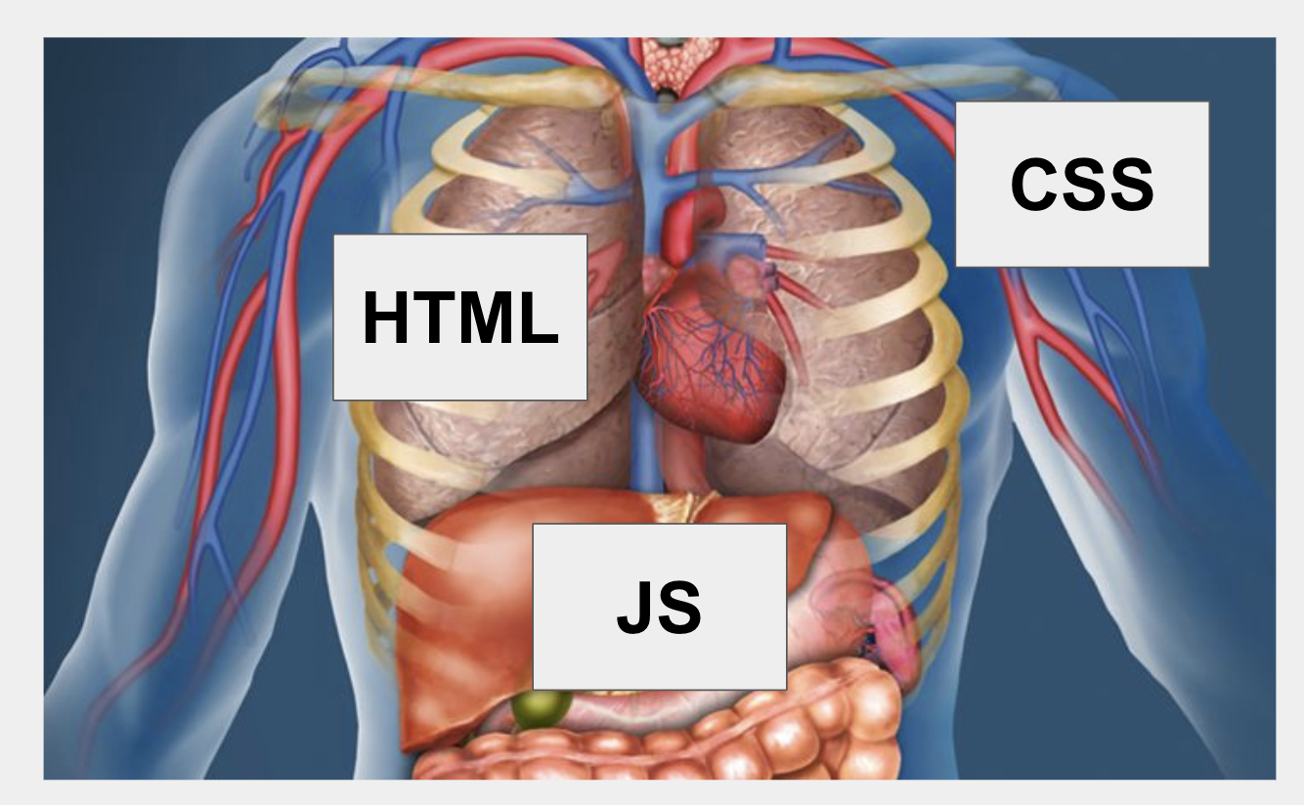
Recap
HTML
CSS
JavaScript
// index.html
// styles.css
// main.js
<div class="title">
Hello World!
</div>
.title { font-size: 18px;
margin: 12px;
}
const printHello = () => {
console.log("Hello World !")
}
Notes:
Before we dive in react
Lets go through what we’re learned so far

Slide 3
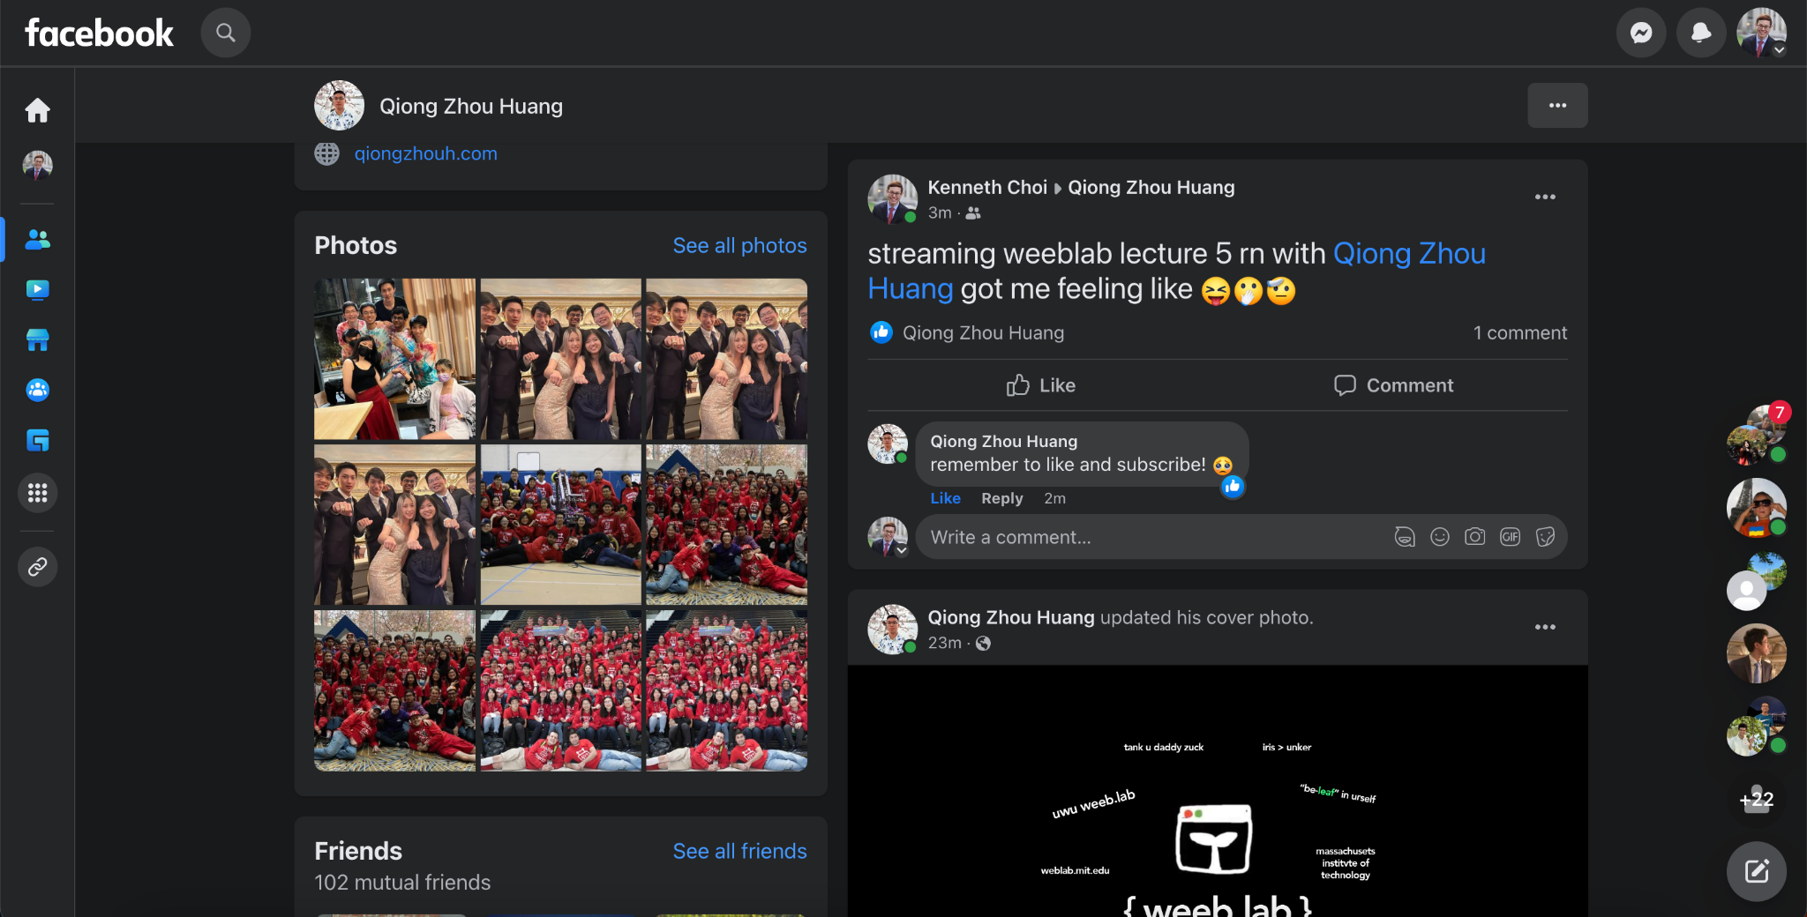
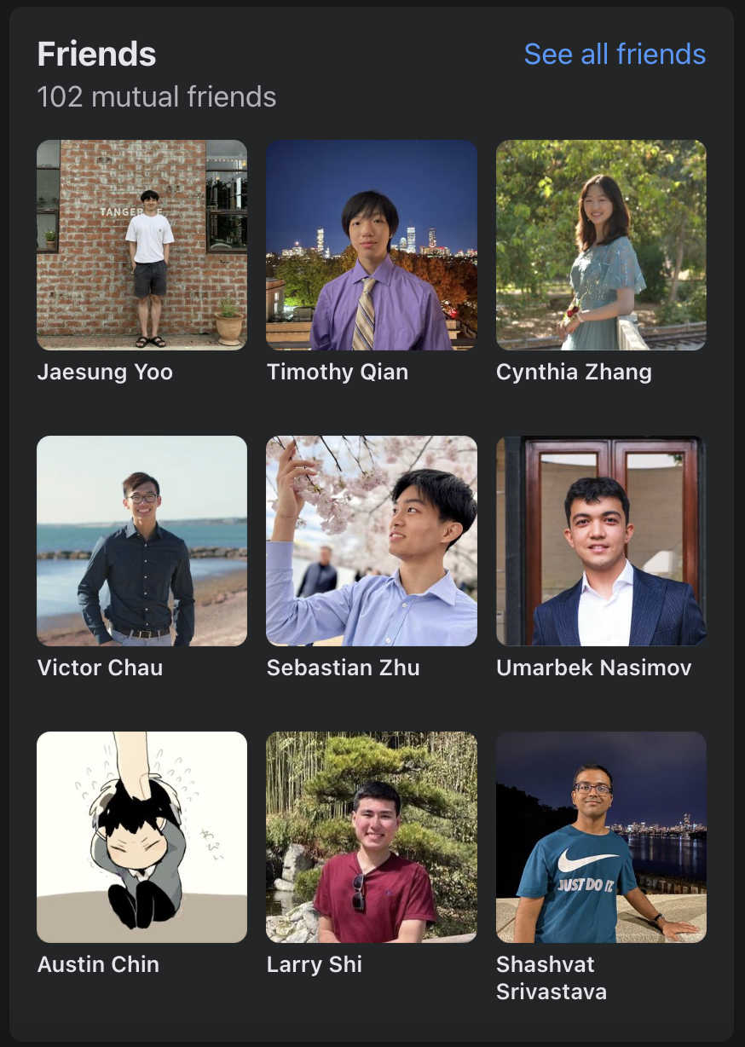
Notes:
Now lets look at an example of a website and try to build it with the tools we currently have
Example facebook feed

Slide 4
<div class="friendsSection">
<div class="friends-header">
<h3>Friends</h3>
<a href="allfriends.html">See all friends</a>
<p>102 mutual friends</p>
</div>
<div class=”friends-images”>
<img src=”jaesung-yoo.png” />
...
<div>
</div>
Notes:
We got the friends section on the left so maybe ill make some div tags,
Give them some styles with css using classes
Theres a ton of people here so i better get working

Slide 5
<div class="friendsSection">
<div class="friends-header">
<h3>Friends</h3>
<a href="allfriends.html">See all friends</a>
<p>102 mutual friends</p>
</div>
<div class=”friends-images”>
<img src=”jaesung-yoo.png” />
...
<div>
</div>
<div>
<div class="header">
<img src="qiongzhouhuang.png" />
<h3>Qiong Zhou Huang</h3>
<p>March 31, 2022</p>
</div>
<div class="post-text">
<img src=”kennethchoi.png” />
<div class="post-text">
streaming weeblab lecture 5 rn with Qiong Zhou Huang got me feeling like 😝🫢🫡
</div>
<div class=”comments-section”>
<div class=”post-comment”>
<h3> Qiong Zhou Huang> </h3>
<p> remember to like and subscribe! </p>
</div>
</div>
<div>
<div class="header">
<img src="qiongzhouhuang.png" />
<h3>Qiong Zhou Huang</h3>
<p>23m</p>
</div>
<img src=”weeblab.png class=”post-image” />
</div>
... (10000 more posts)
...
Notes:
Oh man theres also the posts on the right
Time to make more divs, style all of them
God i have hundreds of posts
And i havent even made anything intereactive yet

Slide 6
<div class=”wrapper-flexbox”>
<div class="friendsSection">
<div class="friends-header">
<h3>Friends</h3>
<a href="allfriends.html">See all friends</a>
<p>102 mutual friends</p>
</div>
<div class=”friends-images”>
<img src=”jaesung-yoo.png” />
...
<div>
</div>
<div>
<div class="header">
<img src="qiongzhouhuang.png" />
<h3>Qiong Zhou Huang</h3>
<p>March 31, 2022</p>
</div>
<div class="post-text">
<img src=”kennethchoi.png” />
<div class="post-text">
streaming weeblab lecture 5 rn with Qiong Zhou Huang got me feeling like 😝🫢🫡
</div>
<div class=”comments-section”>
<div class=”post-comment”>
<h3> Qiong Zhou Huang> </h3>
<p> remember to like and subscribe! </p>
</div>
</div>
<div>
<div class="header">
<img src="qiongzhouhuang.png" />
<h3>Qiong Zhou Huang</h3>
<p>23m</p>
</div>
<img src=”weeblab.png class=”post-image” />
</div>
... (10000 more posts)
...
</div>
Notes:
Maybe we can use flex to organize all of this, but unfortunately this doesn’t solve our original problem, we have way too much code!

Slide 7
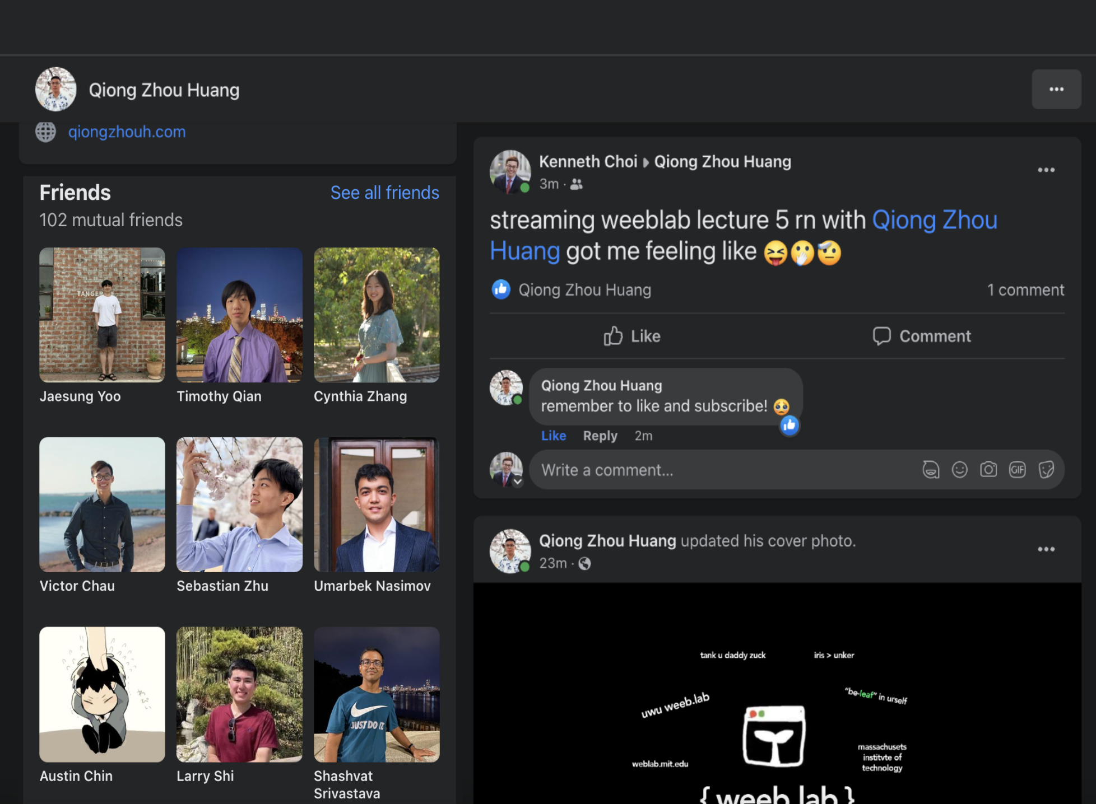

<div class=”wrapper-flexbox”>
<div class="friendsSection">
<div class="friends-header">
<h3>Friends</h3>
<a href="allfriends.html">See all friends</a>
<p>102 mutual friends</p>
</div>
<div class=”friends-images”>
<img src=”jaesung-yoo.png” />
...
<div>
</div>
<div>
<div class="header">
<img src="qiongzhouhuang.png" />
<h3>Qiong Zhou Huang</h3>
<p>March 31, 2022</p>
</div>
<div class="post-text">
<img src=”kennethchoi.png” />
<div class="post-text">
streaming weeblab lecture 5 rn with Qiong Zhou Huang got me feeling like 😝🫢🫡
</div>
<div class=”comments-section”>
<div class=”post-comment”>
<h3> Qiong Zhou Huang> </h3>
<p> remember to like and subscribe! </p>
</div>
</div>
<div>
<div class="header">
<img src="qiongzhouhuang.png" />
<h3>Qiong Zhou Huang</h3>
<p>23m</p>
</div>
<img src=”weeblab.png class=”post-image” />
</div>
... (10000 more posts)
...
</div>

Slide 8


Easy way of writing Facebook
<Facebook />
“Fake” HTML tag
Notes:
What if i told u u cold code all of this in one line
A fake html tag

Slide 9
But where is the Facebook tag defined?
// Facebook.js
<div>
<NavBar />
<Friends />
<Feed />
</div>
Notes:
All of facebook isnt actually a linen of code so
Its actually defined in its own file: Facebook.js
And in it we see that this fake HTML tag Facebook is defined with other things similar to it like, Nav, frens, and feed

Slide 10

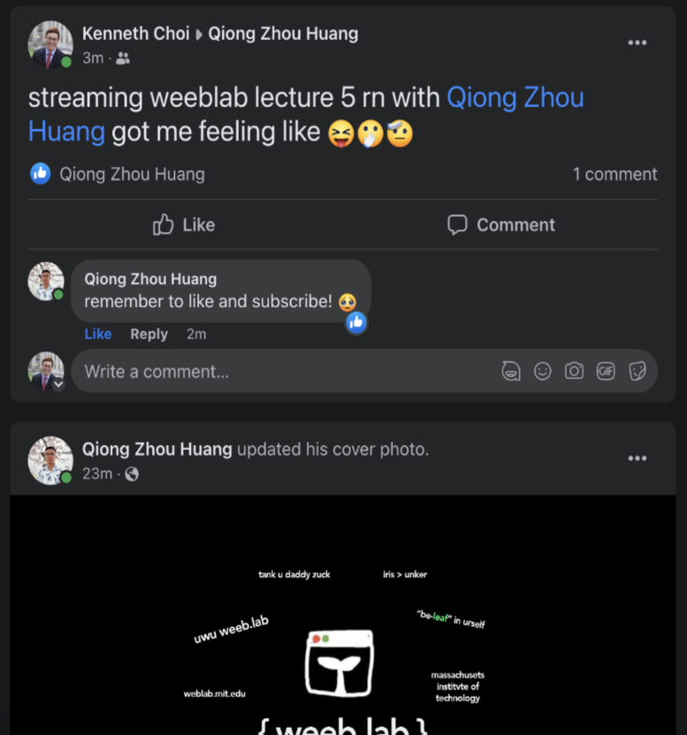
But where are the NavBar, Friends, and Feed tags defined?
// NavBar.js
<div>
<img src=home.png' />
<img src=qiong.png'>
<Separator />
<NavBarButtonGroup />
<Separator />
<Shortcuts />
</div>
// Friends.js
<div>
<img src=’frendo1.png' />
<img src='friend2.png' />
<img src='friend3.png' />
<img src='friend4.png' />
</div>
// Feed.js
<div>
<Post />
<Post />
<Post />
<Post />
</div>
Notes:
But where is navbar, … defined
Well theyhave their own files too
And here you see that they are made of their own fake HTML tags

Slide 11

Notes:
So yea this is the essence of react
React is a JAvascript library used specifically for building large scale user interfaces and websites
Why react?
modular
fast
Easy to understand and use

Slide 12
These 'fake HTML tags' are called Components
Notes:
Javascript library for building user interfaces
All those fake html tags are called components
Why react?
modular
fast
Easy to use

Slide 13
Components
<Facebook />
<NavBar />
<Post />
<Feed />
<InfoBar />
Notes:
Before, normal HTML had HTML elements has its building blocks
For example, you’d nest a <p> in a <div>, and a <b> in a <p>
React lets us create more complicated building blocks called components
Key: Components = building blocks

Slide 14
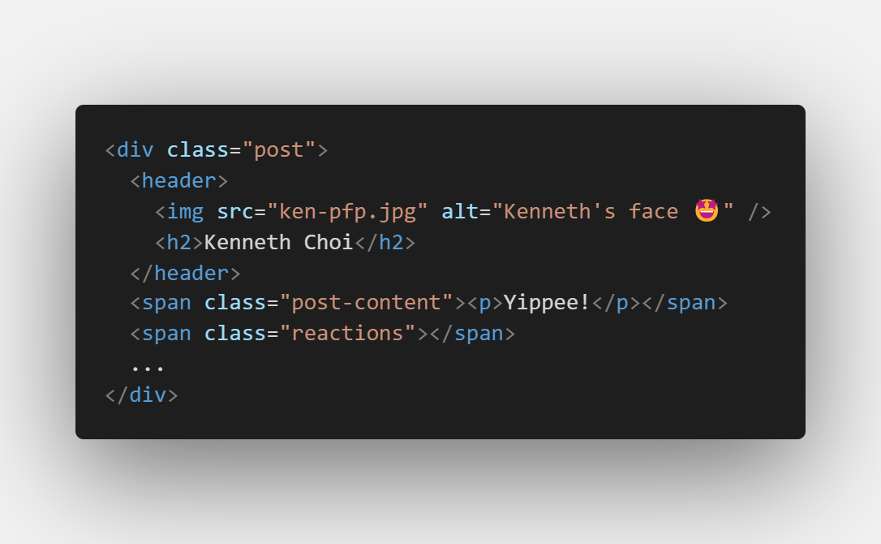
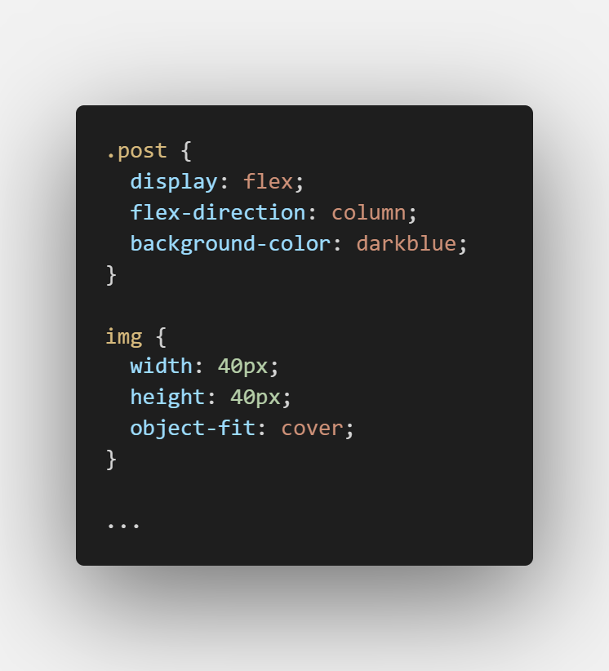
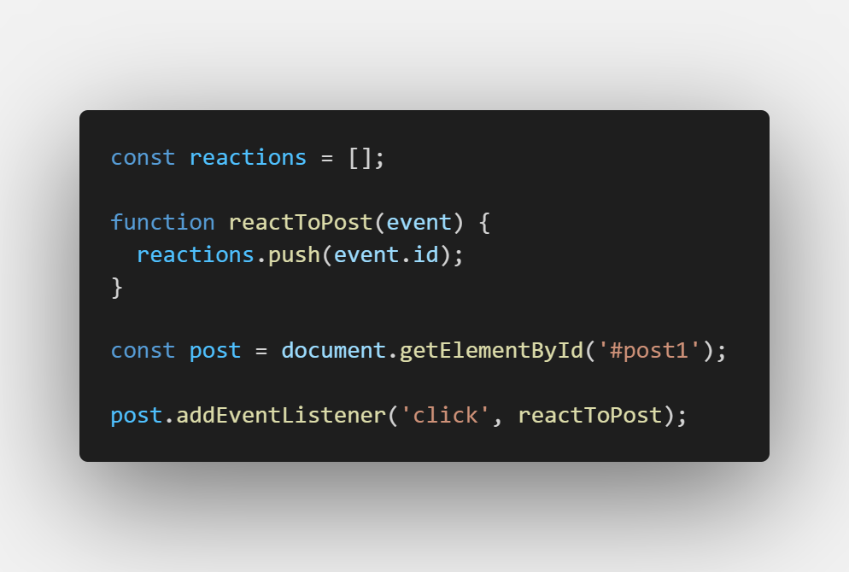
But what is a <Component /> really?
Abstraction for a bunch of HTML, CSS, and Javascript in one file
Fake HTML Tag
Here we call post is a component
<Post />
Notes:
What does a component mean? Abstraction for HTML, CSS, and Javascript in one file.
You’ll see later that we actually implement components only in Javascript, but for now you can think about them like this.

Slide 15
React Apps are “components of components”
The <App /> component
Notes:
In HTML, we can wrap things in div, but in React, our whole website is going to be wrapped in <App>
Ask people to identify components

Slide 16
<App />
<NavBar />
<InfoBar />
<Feed />
Notes:
Don’t ask. Explain that NavBar etc. is a subcomponent of App

Slide 17
<Feed />
<Post />
<Post />
Notes:
The Feed may consist of several post components representing our facebook posts

Slide 18
<PostBody />
<Post />
<Comment />
<PostBody />
Notes:
And PostBody and Comments (comments of a post) may be subcomponents of the Post component

Slide 19
We can think of this structure as a tree…
Notes:
You can see that we have a lot of components nested within each other
We can think about this structure as a tree, with each component being a node in the tree and components having a parent-child relationship

Slide 20

Component Tree Structure
(Also called the “root” component)
App
Feed
InfoBar
NavBar
. . .
Post
Post
. . .
PostBody
Comment
Notes:
Component tree structure: parent component -> child components
At the top (App) we have what is called the root component that represents your entire application
Tree structure useful when outlining your website

Slide 21
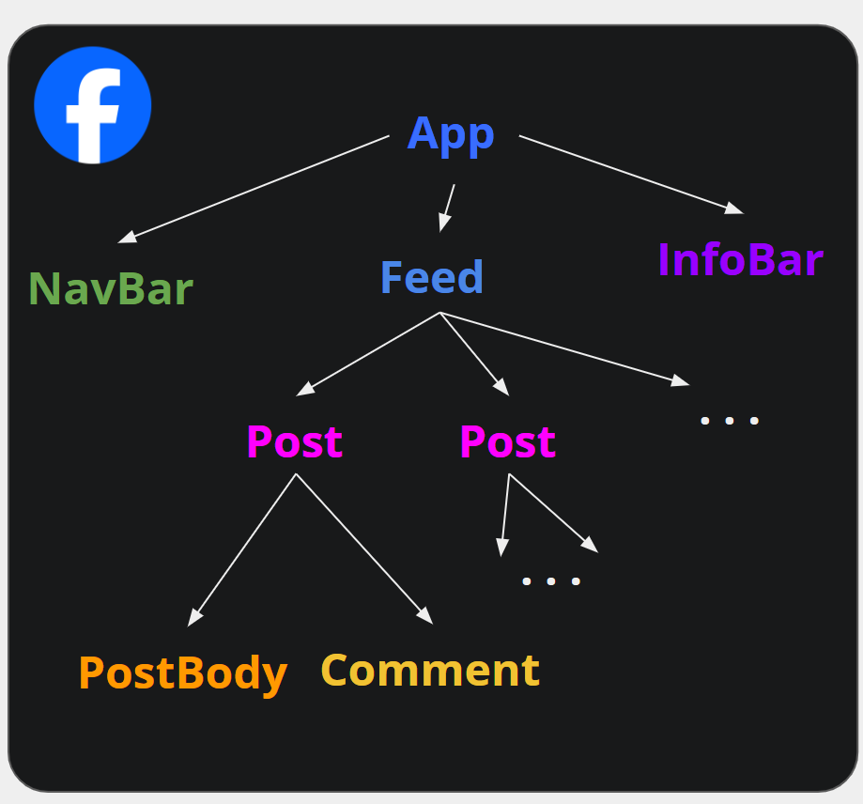
Recap: Components
React is a Framework that lets you divide up your website into reusable components
Each component is kind of like a “custom HTML tag” that you define
Components are an abstraction of a bunch of HTML/CSS/Javascript
The components can be structured into tree hierarchy
Notes:
So to recap… {just list}

Slide 22
Component Structure
Key features of components
Notes:
Let’s look at some key features of components

Slide 23
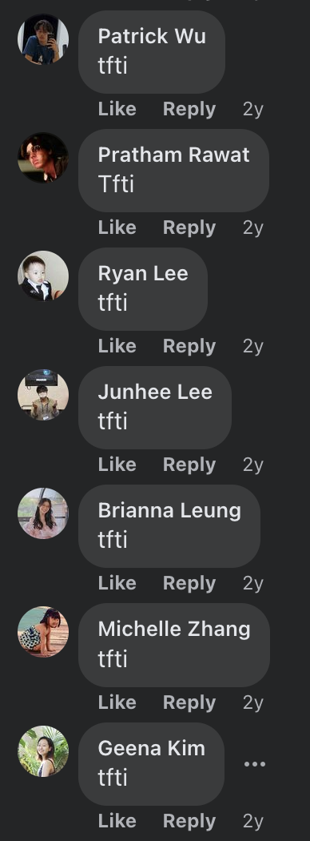




e.g. Comment Component
How can we generalize a comment?
REUSABILITY
Notes:
Let’s figure out how we can use components to our advantage by generalizing a specific feature within our app into something we can reuse.
The keyword here is reusability, we want some way to make the comment component reusable

Slide 24
e.g. Comment Component
How can we generalize this?
profile picture
author name
comment content
date posted
Notes:
Ask: What are some parts of this comment that we can generalize for reusability?

Slide 25
e.g. Comment Component
This is a visualization of the comment component!
Describes how the comment is going to be rendered on screen
Is a “skeleton” or “template” for all comments
profile picture
author name
comment content
date posted
Notes:
And that’s it! It’s that simple. If we can code up the skeleton to display this, we can just pass in different data to the comment component and render any comment on Facebook.
This is all the comment component is; it is a skeleton

Slide 26
?
?
?
profile picture
author name
How do we know what information to display for each comment?
comment content
date posted
?
Notes:
How do comments contain content then? All we have to do now is feed in data… But how?

Slide 27
Props
Information (inputs) passed down from a parent to a child component
Parent
props
Child
Notes:
We use props. Think of these as inputs, properties, arguments, etc.
Strict parent-child relationship. Props go from parent to child.

Slide 28
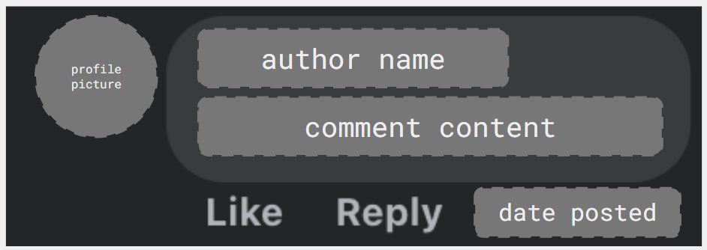
e.g. Comment Props
Recall our tree visualization from earlier…
Parent (Post)
props
Child (Comment)
Rendered Comment
(with props)
Notes:
So again, we want comments to be under a single post, which is the parent component here.
How do we get the rendered comment?

Slide 29
Rendering with Props
Parent (Post)
props:
author name
comment content
date posted
profile picture
profile picture
author name
comment content
?
date posted
Child (Comment)
Notes:
Let’s see this more in depth for rendering a comment

Slide 30
Rendering with Props
Parent (Post)
props:
author name = “Kenneth Choi”
comment content = “me when tsao: 😰🫡”
date posted = 1 minute ago
profile picture = ken-pfp.jpg
profile picture
author name
comment content
date posted
Child (Comment)
Notes:
So we’ll want to pass props from the parent component to the child component. We pass the name, comment content, and date posted.
{Summarize props}
—---------
But why are we passing those props from the parent to the child, when those data are specific to the child?
When we first build our app, we don’t know how many comments there are going to be under a single post
So you can imagine the post has to listen from the server to see if there is a new comment, then render a new instance of a Comment and pass in the data as props
We’ll get to this later, but we can store our comments in an array that the Post component will hold, in something called a state

Slide 31
Rendering with Props
Parent (Post)
X
* Props are immutable!
props:
author name = “Kenneth Choi”
comment content = “me when tsao: 😰🫡”
date posted = 1 minute ago
profile picture = ken-pfp.jpg
CANNOT be passed from child to parent
profile picture
author name
comment content
date posted
Child (Comment)
Notes:
Two important things.
1. Props are immutable; this is a fundamental principle of React!
We should not be modifying props within the component since we are treating them as inputs to the component and we don’t want to be changing inputs arbitrarily…
instead, we should get the parent component to pass in new props.
In react, the component automatically updates whenever props change (if people ask, this is just the design decision the React developers chose)
2. Props can NOT be passed back from child to parent. This is a strict one way street

Slide 32
Props Recap
Props allow us to create reusable components - renders a skeleton with custom content
Props are passed in from parent to child ONLY
Props are immutable
profile picture
author name
comment content
date posted
Notes:
Ok so now we have props passed in, what else are we missing? Are we done making Facebook?

Slide 33
Next, how do we keep track of the displayed content within our website?
E.g. how do we keep track of all the props for each comment?

Slide 34
State
Information maintained by a component
State lets us control what is displayed in the application
State can be updated (i.e. is mutable unlike props)
Can be updated by either human inputs (e.g. button clicks) or computer inputs (e.g. network responses)
Notes:
Sort of like memory. they are private and mutable. Only a unique instance of a Comment component can access how many likes it has, and only that instance of the component can change how many likes it has.

Slide 35
e.g. Post State
Post
How does our app know what to display for each comment?
Comment
Comment
Simplified Facebook, contains a single post with comments

Slide 36
e.g. Post State
<Post/>
Props
State
None
comments[0]
Post
comments[1]
comments[2]
{
authorName: “Kenny”
commentContent: “This is cool!”
datePosted: “1/9/24”
profilePicture: “ken-pfp.jpg”
}
{
authorName: “Enrique”
commentContent: “Silly”
datePosted: “1/9/24”
profilePicture: “eee-pfp.jpg”
}
Comment
Comment
...
Simplified Facebook, contains a single post with comments
Notes:
Post contains information about every single comment in an array. We can think about this comment data as a single Javascript object

Slide 37
e.g. Post State
<Post/>
Props
State
None
comments[0]
Post
comments[1]
comments[2]
<Comment/>
Comment
Comment
Props
State
comments[i]:
...
None
author name
comment content
date posted
profile picture
Simplified Facebook, contains a single post with comments

Slide 38
Why do we keep comment data in <Post/>’s state and not <Comment/>’s state?
→ Allows us to control which comments are displayed under the post
<Post/>
Props
State
None
comments[0]
comments[1]
comments[2]
<Comment/>
Props
State
comments[i]:
...
None
author name
comment content
date posted
profile picture

Slide 39
Motivating Example: Mutating State
<Comment/>
Props
State
<Post/>
comments[0]
None
Props
State
comments[0]
<Comment/>
None
comments[1]
Props
State
comments[1]
None
Notes:
Let’s see some motivating examples for why we’d want to use state and put it in the Post component

Slide 40
Motivating Example: Mutating State
<Comment/>
Props
State
<Post/>
comments[0]
None
Props
State
comments[0]
<Comment/>
None
comments[1]
Props
State
comments[2]
comments[1]
None
<Comment/>
Props
State
comments[2]
None
Notes:
We would not know what data to display if <Comment/> kept its own state

Slide 41

Another Example: Showing Comment Replies
Facebook allows users to see more comment replies (hidden by default)
This can be represented as a mutable toggle that is triggered by human input
Notes:
Some context

Slide 42
Another Example: Showing Comment Replies
What is the best way to implement this in React?
State showReplies in <Reply/>
Prop showReplies in <Reply>
State showReplies in <Comment/>
Prop showReplies in <Comment/>
Comment
Reply
Reply
Reply
Hint: Mutable + updated by human input
Notes:
How should we best implement this in React?
Note our component tree diagram on the right, we have a comment that has multiple replies as child components.
See the hint also.
Raise your hand if A… etc

Slide 43
Another Example: Showing Comment Replies
What is the best way to implement this in React?
State showReplies in <Reply/>
Prop showReplies in <Reply>
State showReplies in <Comment/>
Prop showReplies in <Comment/>
Comment
Reply
Reply
Reply
Hint: Mutable + updated by human input

Slide 44
Another Example: Showing Comment Replies
Use the showReplies state in <Comment/> to control whether or not the replies are displayed
showReplies: false
showReplies: true
<Comment/>
Props
State
comments[i]:
showReplies:
author name
comment content
date posted
profile picture
false/true

Slide 45
State Recap
State is information maintained by components and lets us control what is displayed in the application
State is mutable and updated by external inputs
Can be passed to reusable child components as props
State
comments[0]
comments[1]
comments[2]
Notes:
Ok so now we have props passed in, what else are we missing? Are we done making Facebook?

Slide 46
Component Structure Recap
<Post/>
Components can have props and/or state
Props are passed down from parent components and are immutable
State is data maintained by a component and is mutable
State can be kept in parent components so that it can be passed into reusable child components as props
Props
State
None
comments[0]
comments[1]
comments[2]
<Comment/>
Props
State
comments[i]:
None
author name
comment content
date posted
profile picture
Notes:
Now that we have state, we can keep track of things like whether or not you’ve liked this comment!

Slide 47
Any questions so far?
Ask out loud or on weblab.is/questions!
Notes:
Pass to KEn

Slide 48
Let’s get some practice coding up a React component

Slide 49

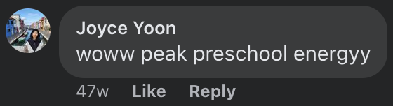
CommentReply.js
Notes:
And for now we’ll go through writing this comment reply component

Slide 50
CommentReply.js
name
content
Notes:
And for now we’ll go through writing this comment reply component

Slide 51

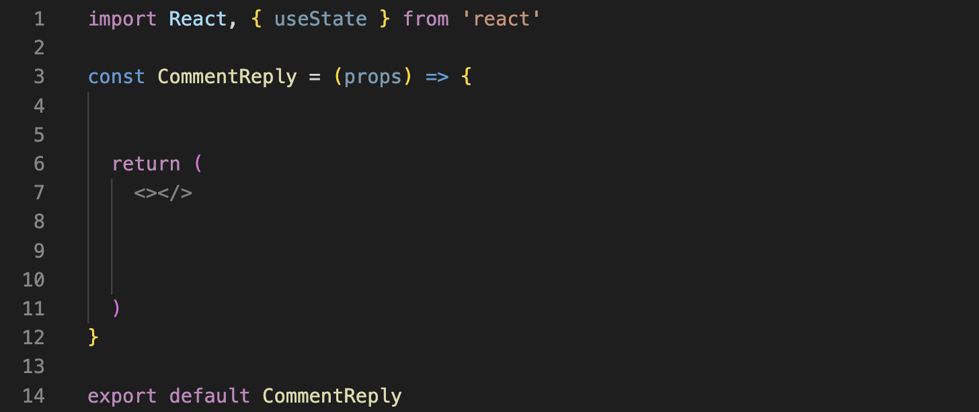


CommentReply.js
Import React library
Define component
Export component
Notes:
We’re gonna want to do the file where we are going to define this replies component
CommentReply.js

Slide 52
CommentReply.js
The CommentReply component is a function that takes in props as an input…
and returns what you want to render as an output
Notes:
We’re gonna want to do the file where we are going to define this replies component
CommentReply.js

Slide 53
CommentReply.js
Function input
The CommentReply component is a function that takes in props as an input…
and returns what you want to render as an output
Function logic (Javascript)
What you want to render (JSX)
Notes:
We’re gonna want to do the file where we are going to define this replies component
CommentReply.js

Slide 54
CommentReply.js
Now, let’s render something

Slide 55
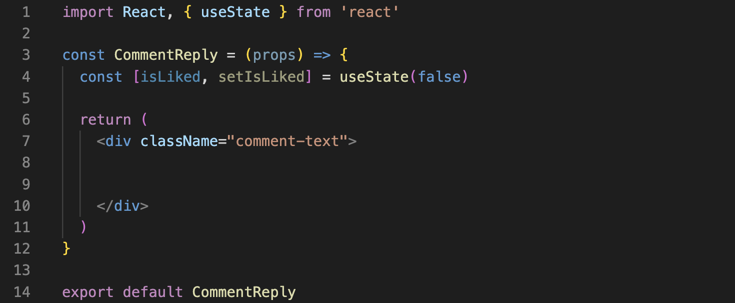

CommentReply.js
Render a div, style it appropriately*
*Note: in React, we use className to access CSS classes
Notes:
We’re gonna want to do the file where we are going to define this replies component
CommentReply.js

Slide 56
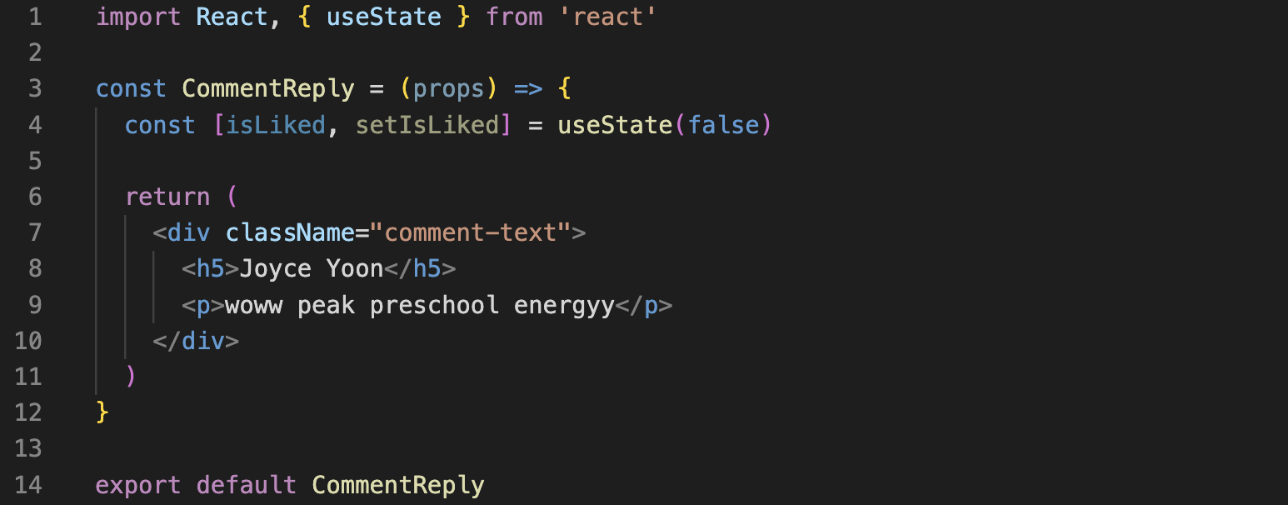
CommentReply.js
Add comment content
Notes:
We’re gonna want to do the file where we are going to define this replies component
CommentReply.js

Slide 57
CommentReply.js
All this hardcoding won’t make our component reusable…
Notes:
Anyone have any ideas????? (Hint: it involves using the inputs of the component) (line 3)

Slide 58
CommentReply.js
All this hardcoding won’t make our component reusable…
use props!
Notes:
We’re gonna want to do the file where we are going to define this replies component
CommentReply.js

Slide 59
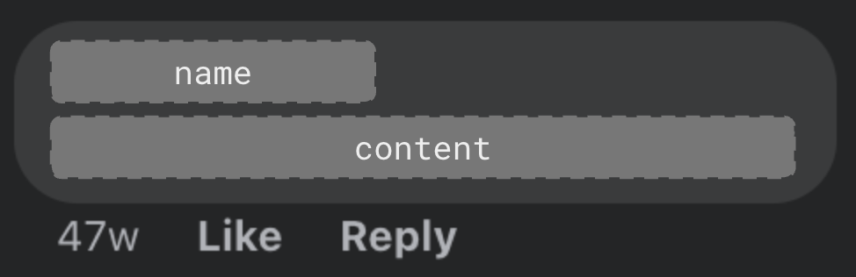
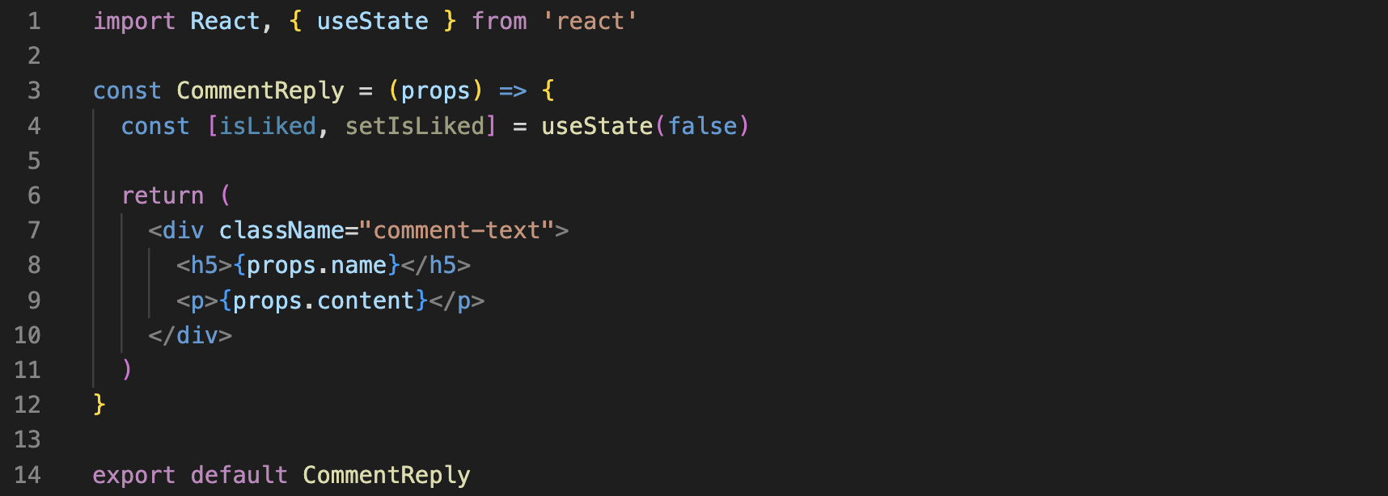
CommentReply.js
React Prop syntax:
Load the comment info from props
Notes:
We’re gonna want to do the file where we are going to define this replies component
CommentReply.js

Slide 60
CommentReply.js
Now this component is reusable (“pure”)!
Notes:
We’re gonna want to do the file where we are going to define this replies component
CommentReply.js

Slide 61
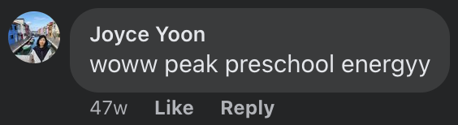
CommentReply.js
Uh… what is JSX again?
Notes:
We’re gonna want to do the file where we are going to define this replies component
CommentReply.js

Slide 62
CommentReply.js
Uh… what is JSX again?
Stricter version of HTML
Notes:
We’re gonna want to do the file where we are going to define this replies component
CommentReply.js

Slide 63
CommentReply.js
Uh… what is JSX again?
Stricter version of HTML
Return JSX = what the React component should render
Notes:
We’re gonna want to do the file where we are going to define this replies component
CommentReply.js

Slide 64
CommentReply.js
Uh… what is JSX again?
Stricter version of HTML
Return JSX = what the React component should render
( ) allows us to write JSX (“HTML”) code inside JavaScript
Notes:
We’re gonna want to do the file where we are going to define this replies component
CommentReply.js

Slide 65
CommentReply.js
Uh… what is JSX again?
Stricter version of HTML
Return JSX = what the React component should render
( ) allows us to write JSX (“HTML”) code inside JavaScript
{} allows us to return to JavaScript inside the JSX environment to use variables defined inside this React Component
Notes:
We’re gonna want to do the file where we are going to define this replies component
CommentReply.js

Slide 66
CommentReply.js
Uh… what is JSX again?
Stricter version of HTML
Return JSX = what the React component should render
( ) allows us to write JSX (“HTML”) code inside JavaScript
{} allows us to return to JavaScript inside the JSX environment to use variables defined inside this React Component
also, notice that we use ‘className’ instead of ‘class’... why?
Notes:
We’re gonna want to do the file where we are going to define this replies component
CommentReply.js

Slide 67
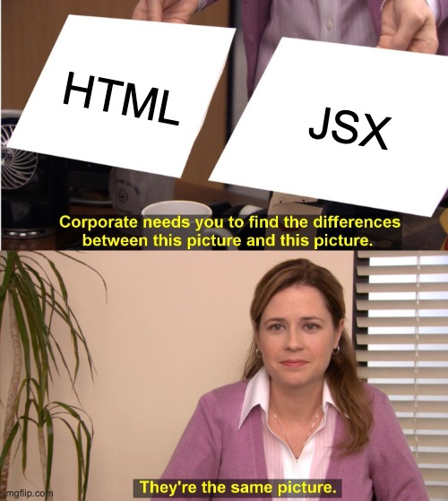
CommentReply.js
Uh… what is JSX again?
Stricter version of HTML
Return JSX = what the React component should render
( ) allows us to write JSX (“HTML”) code inside JavaScript
{} allows us to return to JavaScript inside the JSX environment to use variables defined inside this React Component
Side-by-side differences: https://transform.tools/html-to-jsx
Notes:
MOST of the time…

Slide 68
CommentReply.js
Notes:
We added props to our component to make it reusable.
Now, let’s add a state to our component to maintain component-specified information that can’t easily be passed down as a prop.

Slide 69

CommentReply.js
We added props.
Now let’s add a state to our component!
Notes:
We added props to our component to make it reusable.
Now, let’s add a state to our component to maintain component-specified information that can’t easily be passed down as a prop.

Slide 70
CommentReply.js
React State syntax:
Initializes isLiked state to false
Declares setIsLiked as the function to update isLiked
Example:
setIsLiked(true)will set isLiked to true
Notes:
[After reading] Take a moment to internalize this.

Slide 71
CommentReply.js
Let’s use isLiked to display whether the comment reply is liked or not
Notes:
We’re gonna want to do the file where we are going to define this replies component
CommentReply.js

Slide 72
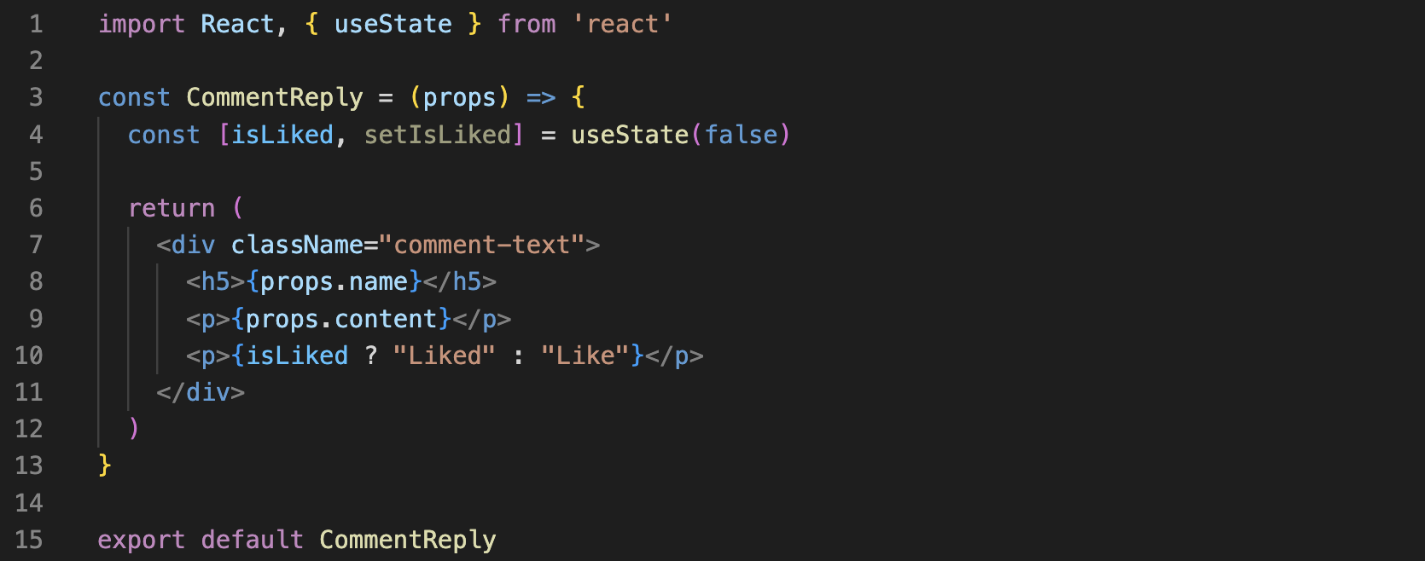
CommentReply.js
Conditionally render text based on the isLiked state
(More on this later)
Notes:
We’ll explain how to update the state in the next example
CommentReply.js

Slide 73

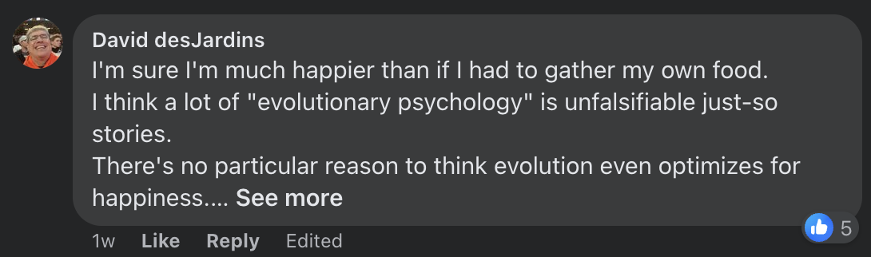

CommentReply.js
Notes:
We’re gonna want to do the file where we are going to define this replies component
CommentReply.js

Slide 74




Notes:
We’re gonna want to do the file where we are going to define this replies component
CommentReply.js

Slide 75
Questions?
Notes:
That’s all the most important content we had to cover in this lecture. Any questions?

Slide 76
We wrote a component!
Now let’s code Facebook.

Slide 77
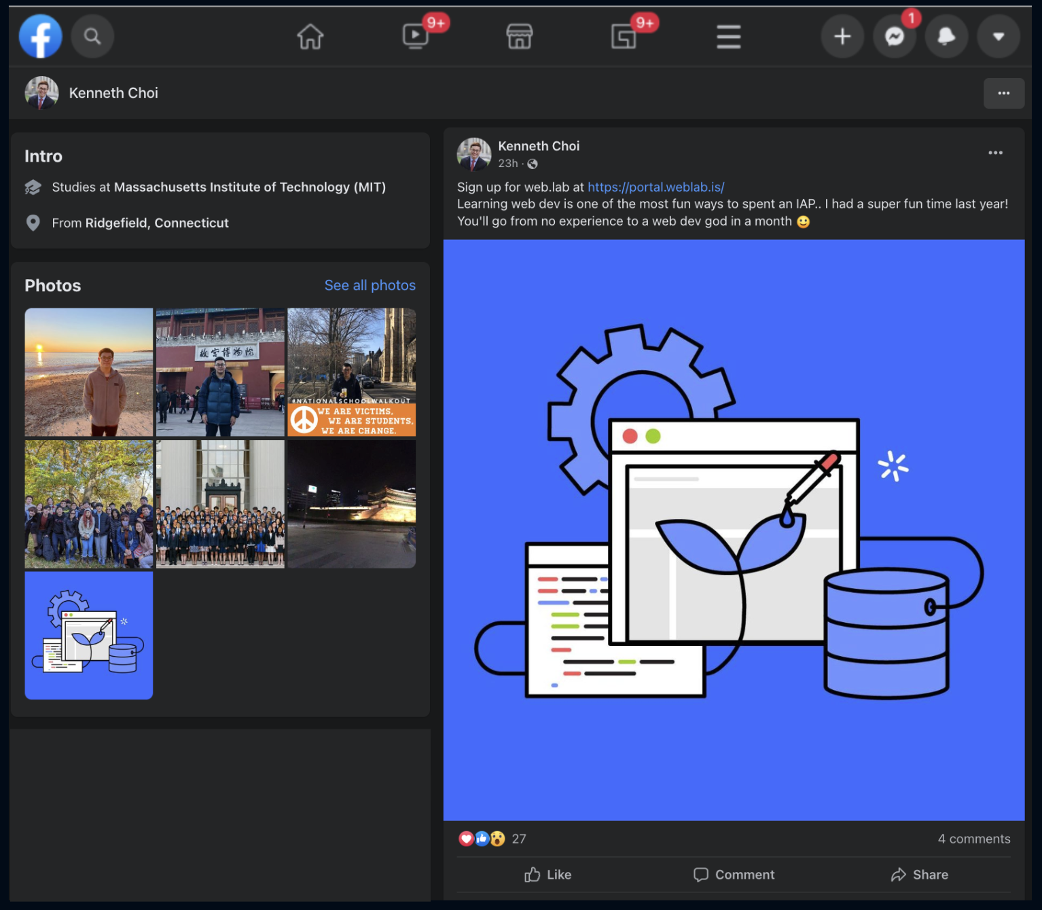
Notes:
So now that we’ve seen how to code a singular component, let’s put everything together and see how several components can come together to make a website.
What is the top level component that we’re going to need for this profile???
App

Slide 78
<App />
Notes:
Can anyone shout out some of the components we can make from this site?
NavBar, Intro, Photos, Post

Slide 79
<App />
<NavBar />
<Intro />
<Photos />
<Post />

Slide 80
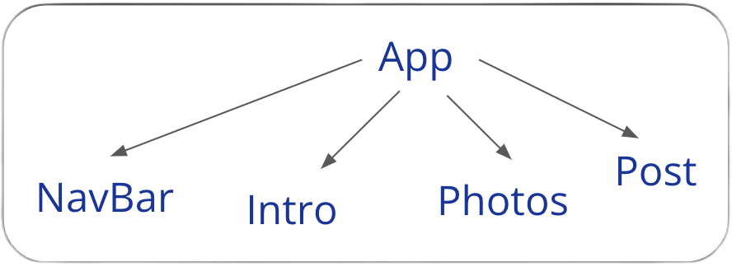
<App />
<NavBar />
<Intro />
<Photos />
<Post />

Slide 81
React components are powerful for abstraction and code reusability.

Slide 82
<NavBar />
(abstraction)
<Intro />
(abstraction)
<Photos />
(abstraction)
<Post />
(reusability
+
abstraction)

Slide 83
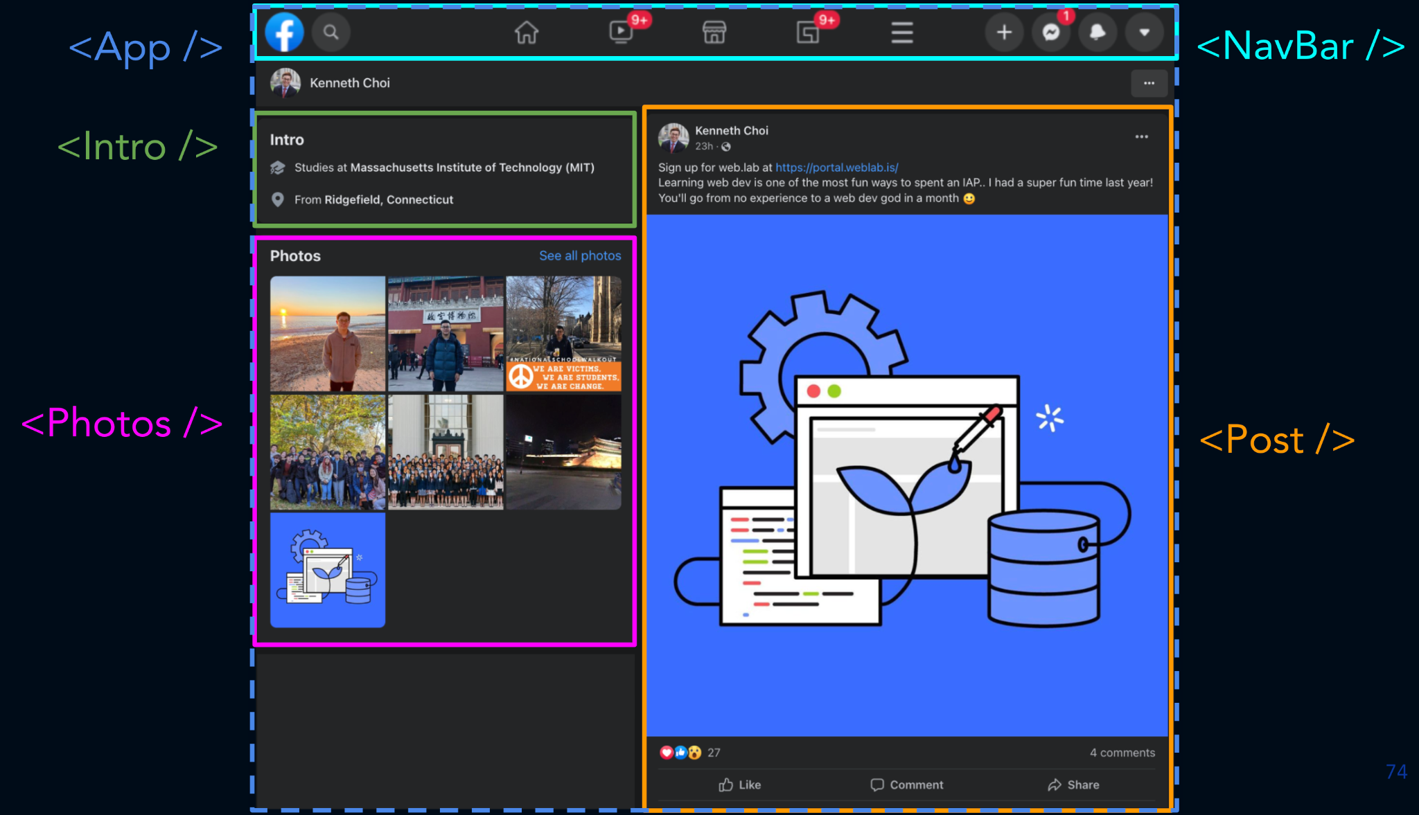
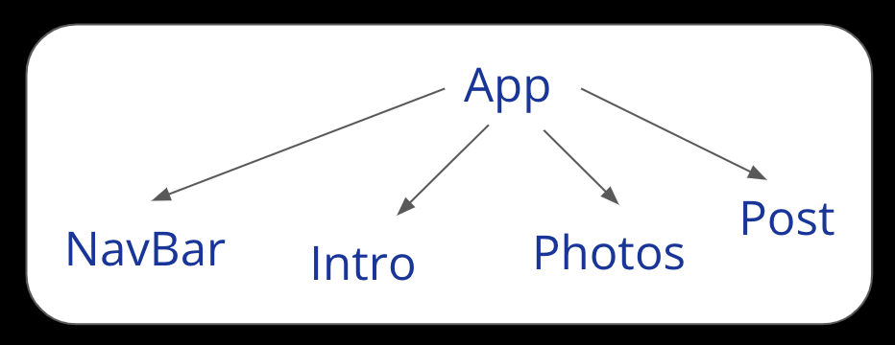
App.js
Notes:
So this is going to be our component tree structure. To make it simple, we’re not going to go further than one layer down, but in reality you’ll want to have a post body and comments on a post.

Slide 84
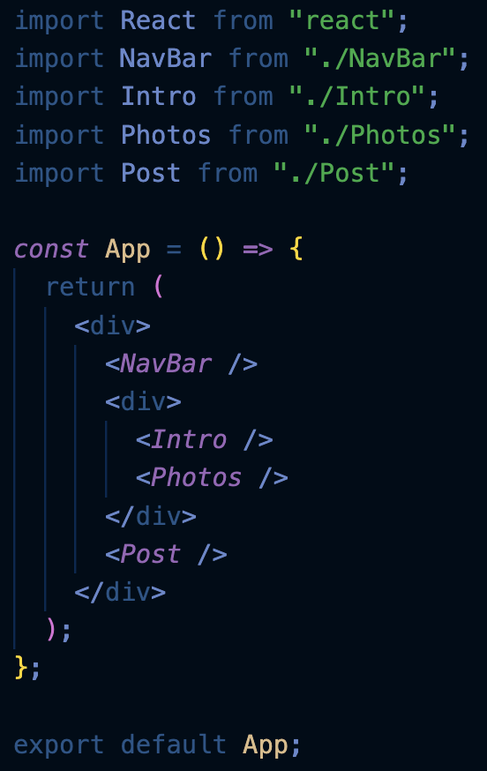
App.js
Notes:
First up is coding App.js. This is the skeleton for our entire website. LOOK AT HOW CLEAN OUR CODE IS BC OF REACT COMPONENTS!
We put one component in each file. We’re importing all the components from their respective files on the top.

Slide 85
App.js
Let’s pass down some props!
Notes:
First up is coding App.js. This is the skeleton for our entire website.
We’re importing all the components from their respective files on the top.
Remember components are just functions that can take in props, and they output JSX, or HTML-like, code.
The App function is going to output the skeleton for our website.

Slide 86
Props
Information passed down from a parent to a child component
Syntax to pass down props:
These are the props!
<Post name="Kenneth" text="Welcome to web lab!" />
Notes:
Recall the definition of props. They are inputs passed from a parent component to a child component.
We can pass props to a child component by listing them when we call the component tag. Here, we’re passing in the properties name and text as two props. React automatically packages this syntax into an Object that has properties name and text. We usually call that object props, and have it as an input for the child component, in this case Post.
So now, we want to pass data from App into the rest of our website, to make our child components as reusable as possible. Let’s do that.
props turns into a Javascript Object: {name: "Kenneth", text: "Welcome to web lab!"} with properties name and text

Slide 87
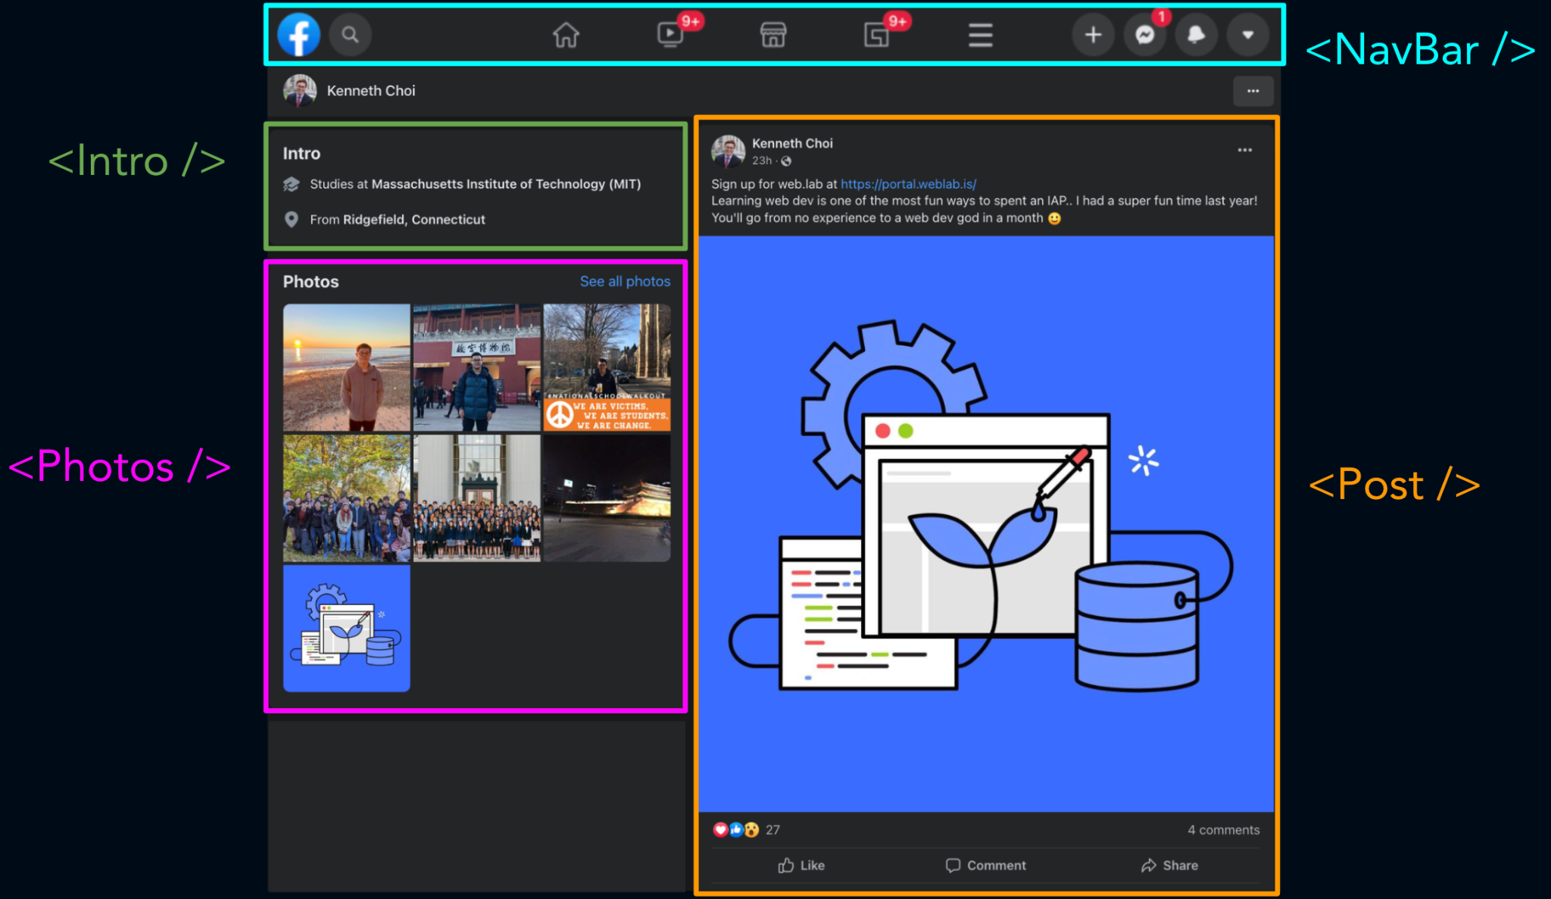
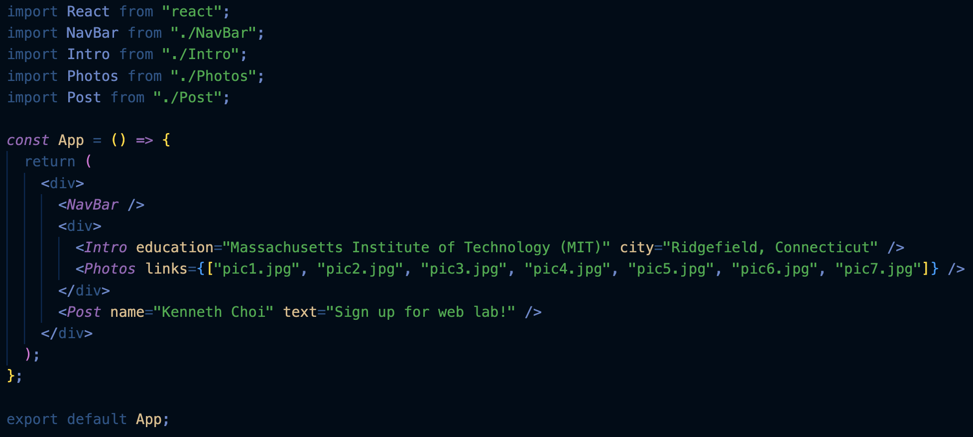
App.js
We pass data from the parent (App) to the child components via props
Notes:
So we’re passing in all the displayed data…

Slide 88
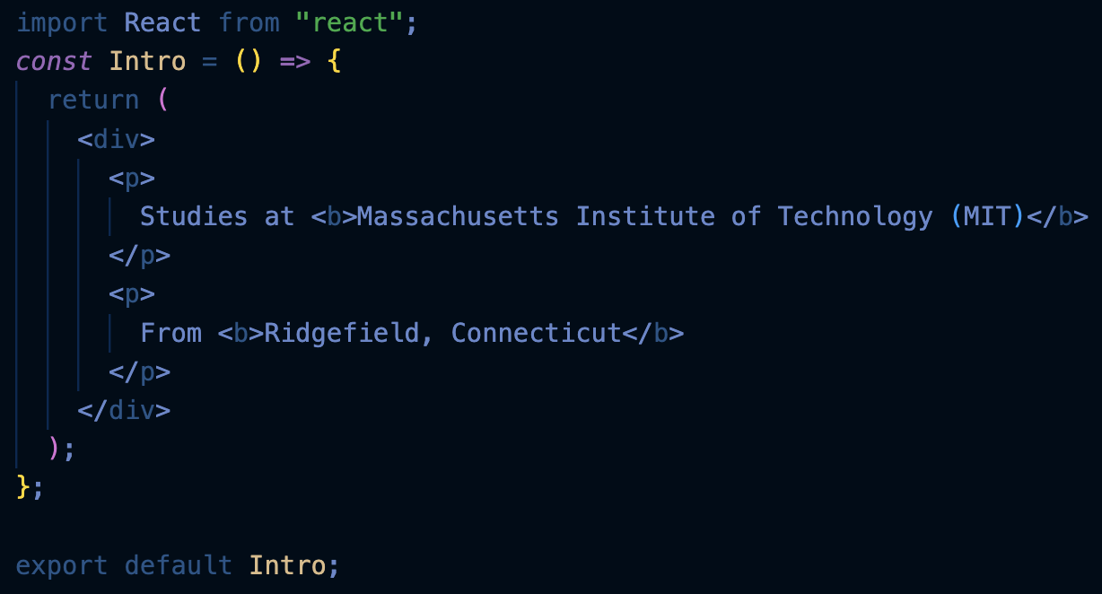

Intro.js
Notes:
Now let’s focus on the Intro component. This is what it’s like without props. We have to hard code in the data.

Slide 89
Let’s use the props we just passed down.
Intro.js
Notes:
Now let’s focus on the Intro component. This is what it’s like without props. We have to hard code in the data.

Slide 90
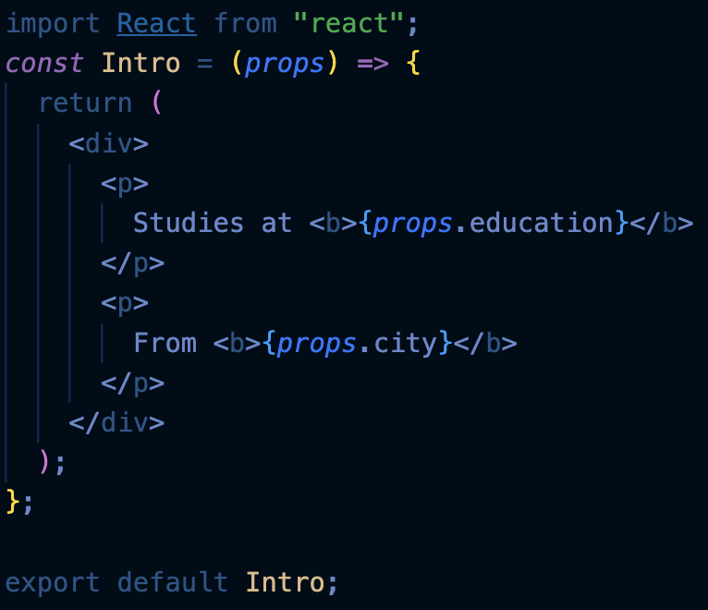
Intro.js
used in App.js:
Notes:
In App, recall that we need to pass in the data. We aren't losing any data, but now Intro.js is reusable instead of unique to only one person.

Slide 91
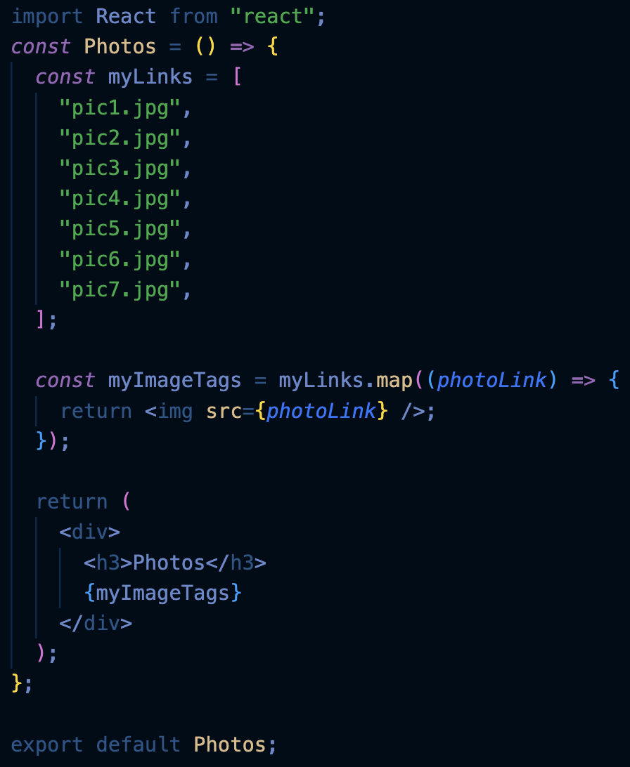
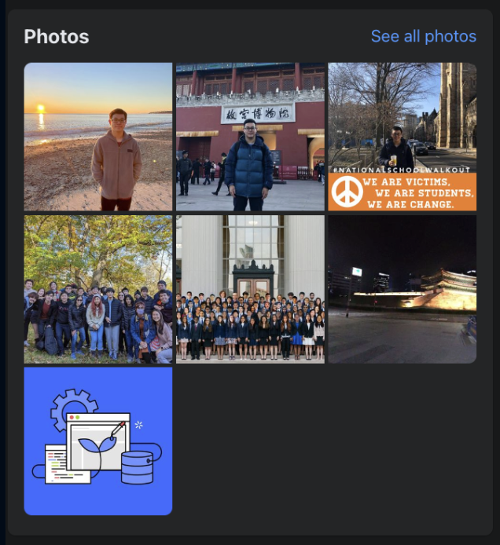
Photos.js
Notes:
Now let’s code up the Photos component.

Slide 92
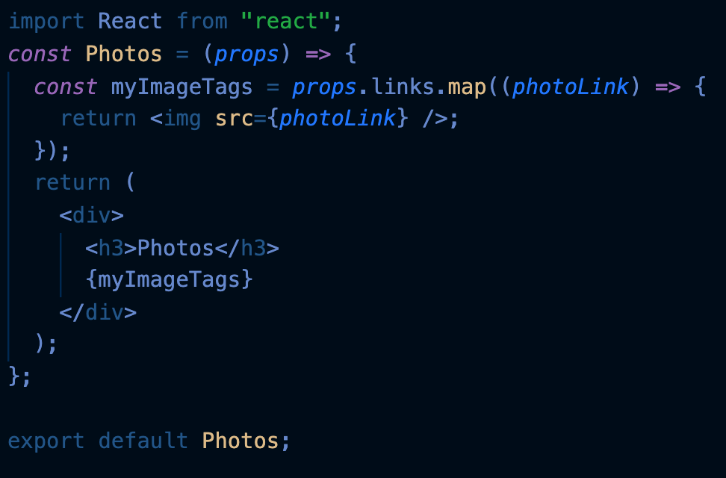
Photos.js
used in App.js:

Slide 93
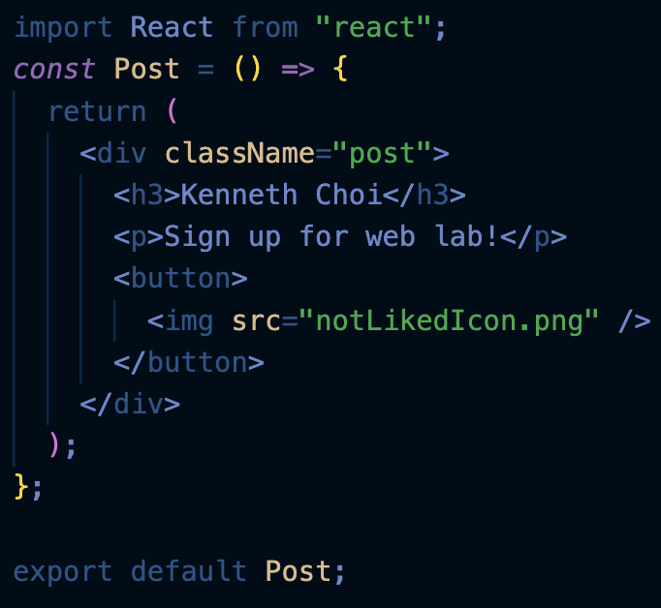
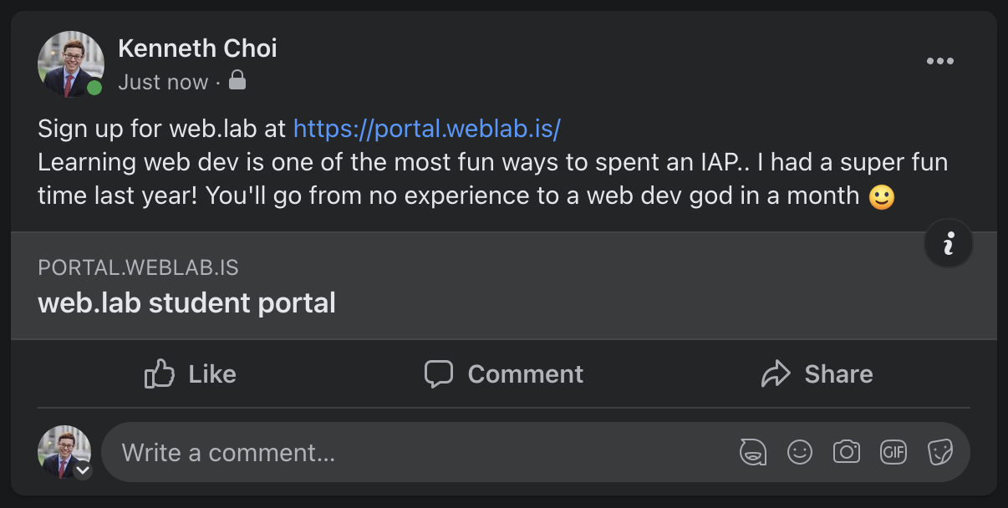

Post.js
Notes:
Finally, let’s code the Post component.

Slide 94
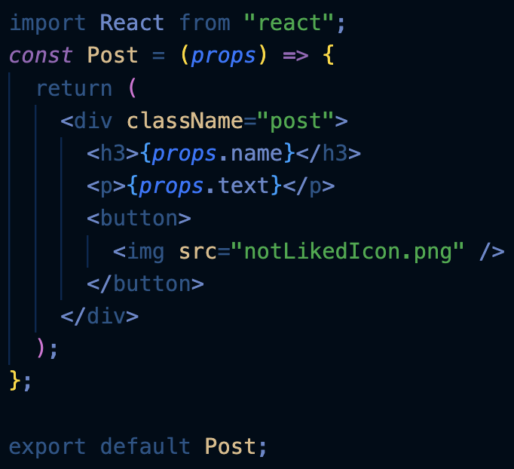
Post.js
used in App.js:
Notes:
We can do the same thing, and replace the data with props that we pass in from App.js.
But now, can anyone tell me why this component is a bit different from our other ones?...

Slide 95
Post.js
?
used in App.js:
Notes:
We need to store whether the post is liked or not, which is unique to each Post. (DON’T ask yet)

Slide 96
Post.js
When the button is clicked, isLiked needs to be updated
Notes:
So again, our variable numLikes need to be stored in the component privately, and we need to be able to update it. What is the best way to store numLikes??
Can anyone answer the the best way to store numLikes??
State!...

Slide 97
Post.js
Store isLiked as a state!

Slide 98
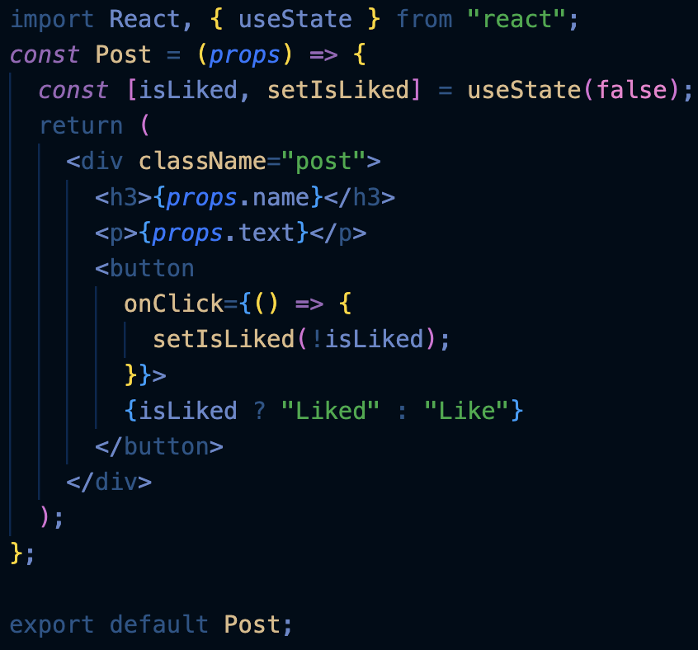
Post.js
state
Notes:
Again, React defines a specific syntax you need to use when defining a new state.
numLikes is the name of the state, and setNumLikes is the function to update the state. setNumLikes takes in a new numLikes as an input.
useState(0) initializes the state to 0.
…
—-
(Setting the state triggers the page to rerender and automatically update the state if it is displayed)

Slide 99
Post.js*
state
*Don’t worry if you don’t get this completely yet!
Notes:
Again, React defines a specific syntax you need to use when defining a new state.
numLikes is the name of the state, and setNumLikes is the function to update the state. setNumLikes takes in a new numLikes as an input.
useState(0) initializes the state to 0.
…
—-
(Setting the state triggers the page to rerender and automatically update the state if it is displayed)

Slide 100
Post.js*
When the button is clicked, isLiked is set to the opposite boolean value
state
*Don’t worry if you don’t get this completely yet!

Slide 101
Post.js*
When the button is clicked, isLiked is set to the opposite boolean value
state
Setting isLiked triggers a re-render…
which switches between rendering “Liked” and “Like”
(More on this tomorrow!)
*Don’t worry if you don’t get this completely yet!

Slide 102
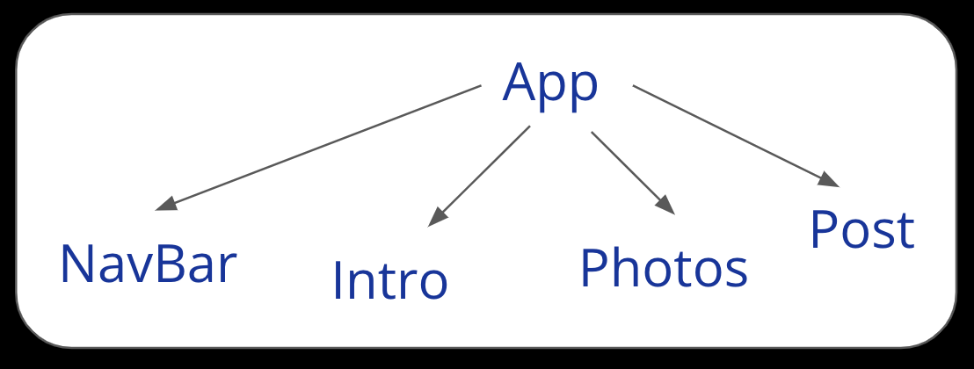
App.js
Only App.js contains data, the child components are reusable and abstracted!
Notes:
So we’ve successfully coded up Facebook!
Notice that we didn’t lose any data. All our data is simply in the outermost layer, App.
Any questions?

Slide 103

Whew.
weblab.is/react-guide

Slide 104
Recap: Writing Components
We divide our app into components, and put one in each file
Each component is a function with props as the input, and returns JSX (HTML-like code)
( ) allows us to enter an JSX environment
Inside the JSX environment, {} allows us to create a mini JS environment

Slide 105
Recap: Writing Components
We pass in props with <Post text="I love weblab" />
We read in those props in the child component with props.text
We declare state variables with
const [something, setSomething] = useState(initialValue)
React uses className instead of class for css styles

Slide 106


















Slide 107
Feedback Time!
weblab.is/feedback

